Slide 1

Weather Forecasting USING python
SANTOSH KUMAR ROY
SoFTWARE ENGINEERING

Slide 2
Sachin Kumar giri
ROLL NO 2K18/IT/102
BRANCH-INFORMATION TECNOLOGY
DELHI TECHNOLOGICAL UNIVESITY

Slide 3
Agenda
INTRODUCTION
PROBLEM DEFINATION
SCOPE
PURPOSE
PROBLEM EXISTING
PROPOSED SYSTEM
PLATFORM & REQUIRMENT
MODULE DESCRIPTION
DESIGN & IMPLEMENT
ALGORITHMS
PSUDO CODE
SCREENSHOTS
CONCLUSION
REFERENCES

Slide 4
INTRODUCTION
Weather forecasting means the prediction of the weather through the application of the principles of physics, supplemented by a variety of statistical and empirical techniques. In addition to predictions of atmospheric phenomena themselves, weather forecasting includes predictions of changes on the Earth’s surface climate. These changes are caused by atmospheric conditions like snow and ice cover, storm tides, and floods.
The basis for weather prediction started with the theories of the ancient Greek philosophers and continued with Renaissance scientists. It was followed by the scientific revolution of the 17th and 18th centuries. The theoretical models of 20th- and 21st-century atmospheric scientists and meteorologists helped for the betterment in applications. The so-called synoptic weather map came to be the principal tool of 19th-century meteorologists. This is used today in weather stations and on television weather reports all over the world. All can happen only through a comprehensive weather forecast. Any weather prediction needs a systematic collection of weather record of various places and proper analysis using the data for prediction.

Slide 5
PROBLEM DEFINATION
Problems concern availability,
timeliness,
quality of observational data;
time constraints on forecast preparation;
the nature and reliability of communication systems available for forecast dissemination;
the makeup and requirements of the user community.

Slide 6

SCOPE
Consistent with the several needs, the scope of long range weather prediction has extended over a wide spectrum ranging from 5 days to periods of the length of months, seasons or more. ... Much of the work done in long-range forecasting of weather by climatic cycles is based on the expected influences of the major planets.

Slide 7
PURPOSE
1. Helps people prepare for how to dress (i.e. warm weather, cold weather, windy weather, rainy weather) 2. Helps businesses and people plan for power production and how much power to use (i.e. power companies, where to set thermostat) 3. Helps people prepare if they need to take extra gear to prepare for the weather (i.e. umbrella, rain coat, sun screen) 4. Helps people plan outdoor activities (i.e. to see if rain/storms/cold weather will impact outdoor event) 5. Helps curious people to know what sort of weather can be expected (i.e. a snow on the way, severe storms)

Slide 8
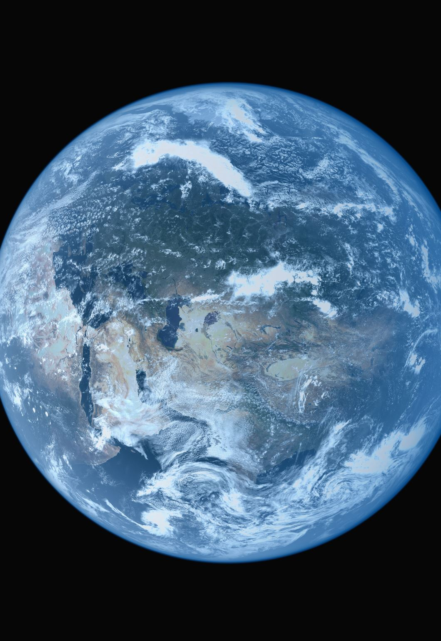
PROPOSED SYSTEM
User will enter current temperature; humidity and wind, System will take this parameter and will predict weather from previous data in database. The role of the admin is to add previous weather data in database, so that system will calculate weather based on these data. Weather forecasting system takes parameters such as temperature, humidity, and wind and will forecast weather based on previous record therefore this prediction will prove reliable.

Slide 9

Openweathermap API
openweathermap is a service that provides weather data, including current weather data, forecasts, and historical data to the developers of web services and mobile applications.

Slide 10
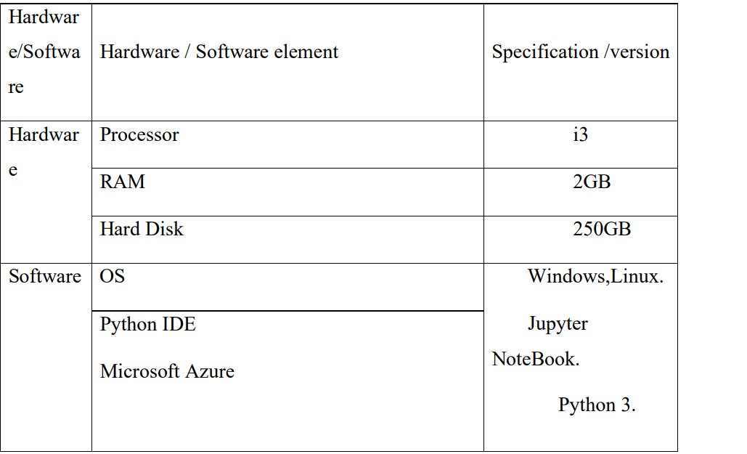
PLATFORM & REQUIREMENT

Slide 11

MODULE DESRIPTION
Modules required:
Tkinter: It is a built-in python library for making GUI using tkinter toolkit.
Requests: It is a library which helps in fetching the data with the help of URL. It can be installed using the below command:
Approach:
Firstly, we have to use a weather API for fetching the data from the Open Weather Map website by generating an API key, and then we need to create a configuration file to store the key. And finally using that configuration file in the python script.
Steps to generate an API key:
Login in the Open Weather Map
Go to the API section. Then in the Current Weather Data section click on the Api doc.
Now in the API Call section, we have the link of api.openweathermap.org/data/2.5/weather?q={city name}&appid={API key}
Click on the API key on the link it will direct to the page from where you can get the key. The generated key looks like this:

Slide 12
Design and implement
Create a file named config.ini.
Import modules in python
We have to first make the body of the GUI with the help of tkinter.
Read the config.ini file and then load the key and URL in the program. .Make a getweather() function to get the weather of a particular location.
.Search function so that we can get the output weather details.

Slide 13

CONCLUSION
Weather forecasts still have their limitations despite the use of modern technology and improved techniques to predict the weather. Weather forecasting is complex and not always accurate, especially for days further in the future, because the weather can be chaotic and unpredictable. If weather patterns are relatively stable, the persistence method of forecasting provides a relatively useful technique to predict the weather for the next day. Weather observation techniques have improved and there have been technological advancements in predicting the weather in recent times. Despite this major scientific and technical progress, many challenges remain regarding long-term weather predictability. The accuracy of individual weather forecasts varies significantly.

